Slide 1


Rockbuster Stealth
Data Dictionary
Catherine Walerko

Slide 2
Table of Contents
2
3
4
5
6
7
8
9
10
11
12
13
14
15
16
17
18
19
Entity Relationship Diagram
Legend
Fact Table: rental
Dimension Table: actor
Dimension Table: address
Dimension Table: category
Dimension Table: city
Dimension Table: country
Dimension Table: customer
Dimension Table: film
Dimension Table: film_actor
Dimension Table: film_category
Dimension Table: inventory
Dimension Table: language
Dimension Table: payment
Dimension Table: staff
Dimension Table: store

Slide 3
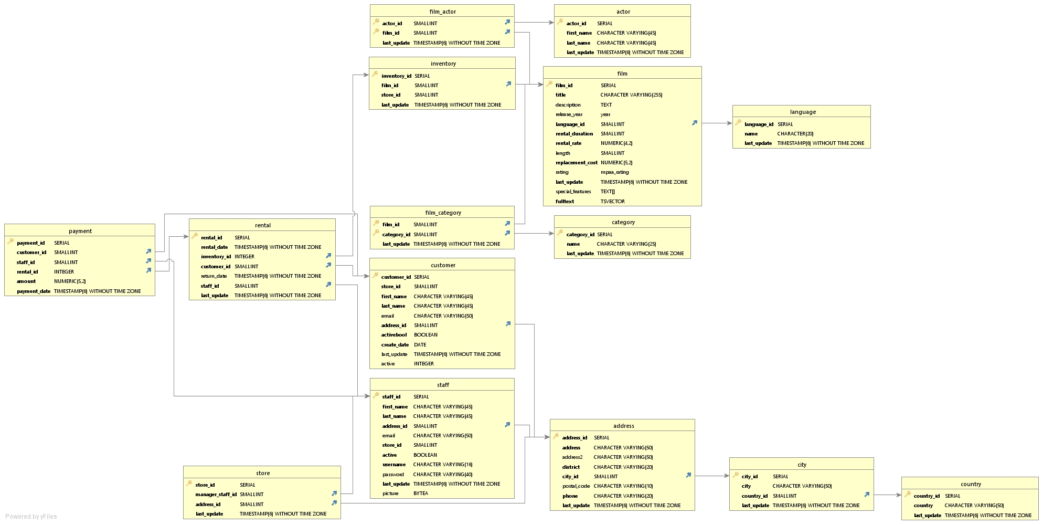
Entity Relationship Diagram

Slide 4


Legend
Primary Key
Foreign Key

Slide 5
Fact Table: rental
 | rental
Key | Columns | Data Type | Description | Links With
 | rental_id | SERIAL | A unique ID for each movie rental | payment
 | rental_date | TIMESTAMP(6) WITHOUT TIME ZONE | Date and Time the rental occured
 | inventory_id | INTEGER | The ID for how many copies of the movie there are | inventory
 | customer_id | SMALLINT | The unique ID for each customer | customer
 | return_date | TIMESTAMP(6) WITHOUT TIME ZONE | The date and time the rental was returned
 | staff_id | SMALLINT | The unique ID for each staff member | staff
 | last_update | TIMESTAMP(6) WITHOUT TIME ZONE | Date and time the table was last updated

Slide 6
Dimension Table: actor
 | actor
Key | Columns | Data Type | Description | Links With
 | actor_id | SERIAL | The unique ID for each actor | Film_actor
 | first_name | CHARACTER VARYING(45) | First name of the actor
 | last_name | CHARACTER VARYING(45) | Last name of the actor
 | last_update | TIMESTAMP(6) WITHOUT TIME ZONE | Date and time the table was last updated

Slide 7
Dimension Table: address
 | address
Key | Columns | Data Type | Description | Links With
 | address_id | SERIAL | Address ID number | customer, staff, store
 | address | CHARACTER VARYING(50) | Line 1 of address
 | address 2 | CHARACTER VARYING(50) | Line 2 of address
 | district | CHARACTER VARYING(20) | Address disctrict
 | city_id | SMALLINT | ID of city | city
 | postal_code | CHARACTER VARYING(10) | Postal code
 | phone | CHARACTER VARYING(20) | Phone number
 | last_update | TIMESTAMP(6) WITHOUT TIME ZONE | Date and time the table was last updated

Slide 8
Dimension Table: category
 | category
Key | Columns | Data Type | Description | Links With
 | category_id | SERIAL | The unique ID for movie genre | film, category
 | name | CHARACTER VARYING(25) | Name of genre
 | last_update | TIMESTAMP(6) WITHOUT TIME ZONE | Date and time the table was last updated

Slide 9
Dimension Table: city
 | city
Key | Columns | Data Type | Description | Links With
 | city_id | SERIAL | ID of city | address
 | city | CHARACTER VARYING(50) | Name of city
 | country_id | SMALLINT | ID of country | country
 | last_update | TIMESTAMP(6) WITHOUT TIME ZONE | Date and time the table was last updated

Slide 10
Dimension Table: country
 | country
Key | Columns | Data Type | Description | Links With
 | country_id | SERIAL | ID of country | city
 | country | CHARACTER VARYING(50) | Name of country
 | last_update | TIMESTAMP(6) WITHOUT TIME ZONE | Date and time the table was last updated

Slide 11
Dimension Table: customer
 | customer
Key | Columns | Data Type | Description | Links With
 | customer_id | SERIAL | The unique ID for each customer | payment, rental
 | store_id | SMALLINT | The unique ID for each store | store
 | first_name | CHARACTER VARYING(45) | First name of the customer
 | last_name | CHARACTER VARYING(45) | Last name of the customer
 | email | CHARACTER VARYING(50) | Customer email address
 | address_id | SMALLINT | Customer address | address
 | activebool | BOOLEAN | Active status of customer
 | create_date | DATE | Date customer joined
 | last_update | TIMESTAMP(6) WITHOUT TIME ZONE | Date and time the table was last updated
 | active | INTEGER | Active status of customer

Slide 12
Dimension Table: film
 | film
Key | Columns | Data Type | Description | Links With
 | film_id | SERIAL | The unique ID for each movie | film_actor, film_category, inventory
 | title | CHARACTER VARYING(255) | Name of Movie
 | description | TEXT | Movie synopsis
 | release_year | Year | Year move released
 | language_id | SMALLINT | Language spoken in movie | language
 | rental_duration | SMALLINT | How long movie was rented
 | rental_rate | NUMERIC(4,2) | price to rent movie/time period
 | length | SMALLINT | Movie length
 | replacement_cost | NUMERIC(5,2) | Cost to replace lost/damaged movie
 | rating | mpaa_rating | Film rating
 | last_update | TIMESTAMP(6) WITHOUT TIME ZONE | Date and time the table was last updated
 | special_features | TEXT() | Any bonus features with movie
 | fulltext | TSVECTOR | Keywords

Slide 13
Dimension Table: film_actor
 | film_actor
Key | Columns | Data Type | Description | Links With
 | actor_id | SMALLINT | The unique ID for each actor | actor
 | film_id | SMALLINT | The unique ID for each movie | film
 | last_update | TIMESTAMP(6) WITHOUT TIME ZONE | Date and time the table was last updated

Slide 14
Dimension Table: film_category
 | film_category
Key | Columns | Data Type | Description | Links With
 | film_id | SMALLINT | The unique ID for each movie | film
 | category_id | SMALLINT | The unique ID for movie genre | category
 | last_update | TIMESTAMP(6) WITHOUT TIME ZONE | Date and time the table was last updated

Slide 15
Dimension Table: inventory
 | Inventory
Key | Columns | Data Type | Description | Links With
 | inventory_id | SERIAL | The ID for how many copies of the movie there are | rental
 | film_id | SMALLINT | The unique ID for each movie | film
 | store_id | SMALLINT | The unique ID for each store | store
 | last_update | TIMESTAMP(6) WITHOUT TIME ZONE | Date and time the table was last updated

Slide 16
Dimension Table: language
 | language
Key | Columns | Data Type | Description | Links With
 | language_id | SERIAL | Language spoken in movie | film
 | name | CHARACTER VARYING(20) | Name of language
 | last_update | TIMESTAMP(6) WITHOUT TIME ZONE | Date and time the table was last updated

Slide 17
Dimension Table: payment
 | payment
Key | Columns | Data Type | Description | Links With
 | payment_id | SERIAL | The unique ID for the transaction
 | customer_id | SMALLINT | The unique ID for each customer | customer
 | staff_id | SMALLINT | The unique ID for each staff member | staff
 | rental_id | INTEGER | A unique ID for each movie rental | rental
 | amount | NUMERIC(5,2) | The amount paid for the rental
 | payment_date | TIMESTAMP(6) WITHOUT TIME ZONE | Date and time the rental transaction occured

Slide 18
Dimension Table: staff
 | staff
Key | Columns | Data Type | Description | Links With
 | staff_id | SERIAL | An employee’s unique ID | payment, rental
 | store_id | SMALLINT | The unique ID for each store | store
 | first_name | CHARACTER VARYING(45) | First name of the employee
 | last_name | CHARACTER VARYING(45) | Last name of the employee
 | address_id | SMALLINT | Employee address | address
 | email | CHARACTER VARYING(50) | Employee email address
 | activebool | BOOLEAN | Employee employment status
 | username | CHARACTER VARYING(16) | Employee’s work username
 | password | CHARACTER VARYING(40) | Employee’s work password
 | last_update | TIMESTAMP(6) WITHOUT TIME ZONE | Date and time the table was last updated
 | picture | BITEA | Employee photo

Slide 19
Dimension Table: store
 | store
Key | Columns | Data Type | Description | Links With
 | store_id | SERIAL | The unique ID for each store | customer, inventory, staff
 | manager_staff_id | SMALLINT | The store’s manager’s ID
 | address_id | SMALLINT | Store address | address
 | last_update | TIMESTAMP(6) WITHOUT TIME ZONE | Date and time the table was last updated

